Slide 1

Telecom churn
Presented By : Madhumita Roy

Slide 2
Introduction
In the telecom industry, customers are able to choose from multiple service providers and actively switch from one operator to another. In this highly competitive market, the telecommunications industry experiences an average of 15-25% annual churn rate. Given the fact that it costs 5-10 times more to acquire a new customer than to retain an existing one, customer retention has now become more important than customer acquisition.
For many incumbent operators, retaining highly profitable customers is the number one business goal.
To reduce customer churn, telecom companies need to predict which highly profitable customers are at risk of churn.

Slide 3
Business problem
Retaining high-value customers is critical to reducing revenue leakage.
Predicting churn in high-value customers can help in taking proactive actions.
Use customer data from a leading telecom firm to predict churn and identify key indicators.

Slide 4
Understanding Churn Models & Definition of Churn
Churn Models in Telecom:
Postpaid customers: They terminate services directly, sas a result are easy to track.
Prepaid customers: They may stop using services without notice.
Importance: Prepaid churn prediction is more critical in India and Southeast Asia, where prepaid is common.
Definition of Churn :
Revenue-Based Churn: No usage of revenue-generating services (e.g., calls, SMS) for a given period.
Usage-Based Churn: No usage (incoming/outgoing calls, internet, etc.) for a specific time.
Churn Definition Used: Usage-based churn, focusing on a lack of calls or data usage.

Slide 5
Focus on High-Value Churn
High-value customers are those in the top 30% of recharge amounts in the first two months.
Reduce churn in high-value customers to prevent significant revenue loss.
80% of revenue comes from 20% of high-value customers.
Understanding the Dataset
Customer-level data obtained was from June to September (4 months).
We need to predict churn in September using data from June, July, and August.
Phases:
Good Phase: First two months (June & July).
Action Phase: Third month (August).
Churn Phase: Fourth month (September).

Slide 6
Data Preparation
Filtering High-Value Customer:
Customers whose average recharge in June & July is above the 70th percentile were selected.
This reduces the dataset to about 30,000 rows.
Tagging Churners:
Customers who didn’t make any calls or use data in the churn phase (September) are tagged as churners.
Data Cleanup:
All features related to the churn phase are removed (September) for prediction purposes.

Slide 7
Modelling Approach
Churn in high-value customers needs to be predicted.
Identifying important predictors of churn to inform business decisions is an important step.
Modeling Techniques:
Logistic Regression wasd used to handle the class imbalance.
Multicollinearity needs to be handled to identify significant features.

Slide 8
Class Imbalance & Model Performance
Challenge: The churn rate is low (5-10%).
Model Evaluation: Metrics such as accuracy, precision, recall, and F1-score will be used.
Key Predictors of Churn :
Identifying Important Variables:
Logistic regression reveals which variables are most strongly associated with churn.
Example of important features: call volumes, internet usage patterns, recharge amounts.

Slide 9
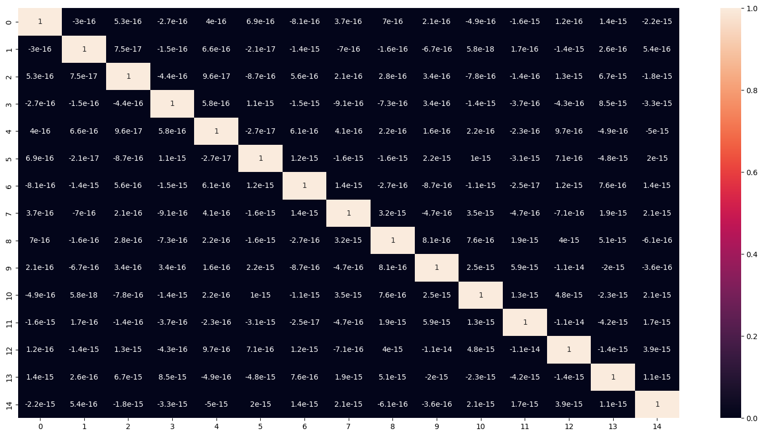
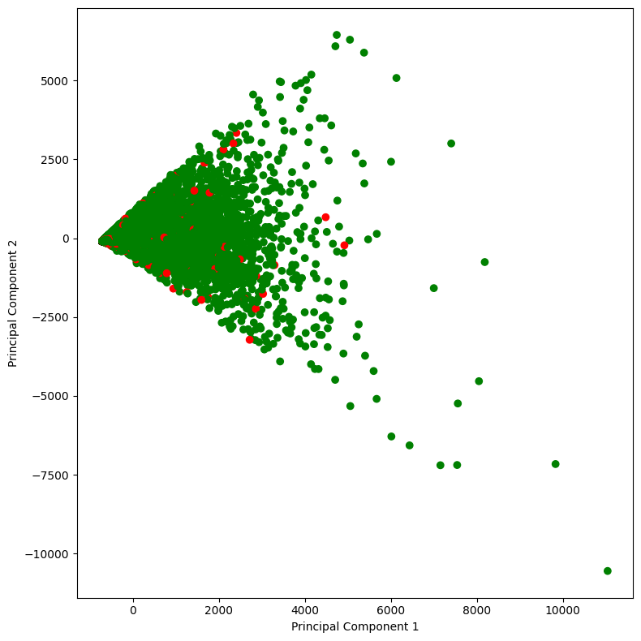
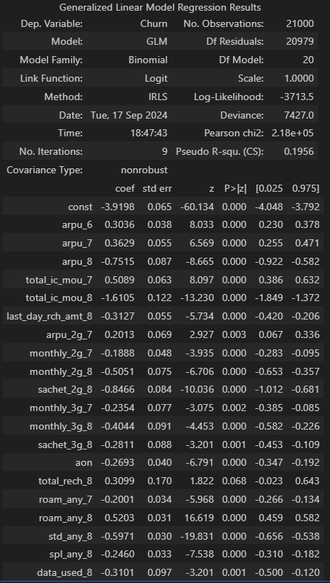
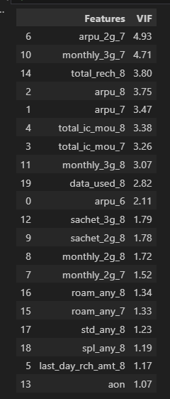
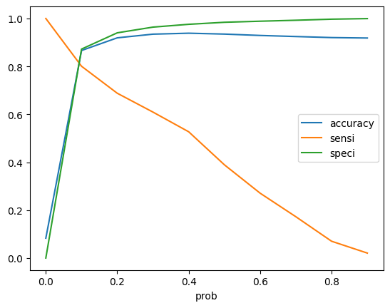
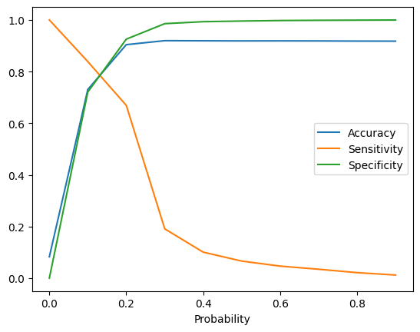
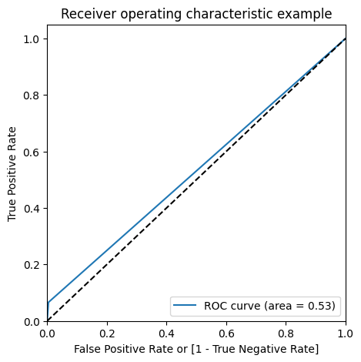
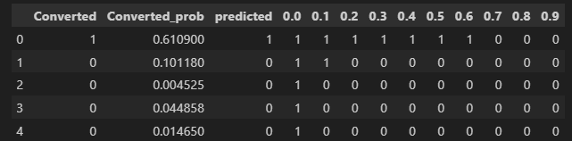
Visualization Results
Some important plots and tables.

Slide 10
Factors responsible & Recommendations
We notice that the following 5 factors affect the churn rate considerably -
Total Incoming Minutes of usage in the August
Total Incoming Minutes of usage in the July
2G data pack
Roaming
Sachet 2g Also these metrics are inversely proportion to churn which means that we need to come up with campaigns that would keep people engaged either via calls (incoming) or on internet. One interesting thing to note here is that we see that a lot of people are hooked on 2G and hence are not churning. It presents us with a great opportunity that if shift these people from 2g to 3g then we have a greater chance of these people not churning. Hence discounts on 3G pack can be one of the popular maarketing campaigns

Slide 11
The number of recharges, amount of recharge and the last day of recharge are important indicators of customer usage. If any of them decrease, it could be a sign that the customer is trying to wait the remaining period of validity and then try to switch providers. Recharge packs with discount can be offered during this period to retain customer.
Internet usage is also an important variable as it indicates if the customer is actively using the mobile for operations such as social networking, mobile banking, bill payments etc., and any reduction/non-usage indicates higher possibility of churn. Data Packs can be offered as a bundle/reduced prices/free for a month to attract customer to be in the network.
Incoming and Outgoing calls in the last good month 7 and action phase month 8 also need to be taken into consideration
STD, ISD & Special incoming calls for month 8 need to monitored for usage consistently and see if we are able to identify any drop in the usage pattern
Depending on the volume based cost for 8th month, we can observe if the customer is making a commitment to stay further on the network through month 9
Average revenue per user should also be monitored for reduction in consumption which would indicate potential customer churn

Slide 12
Business Implications:
The business implications of these factors impacting churn and customer behavior are crucial for designing targeted retention strategies. Here's how each finding can influence business decisions:
Incoming Minutes Usage (July & August)
Since incoming minutes are inversely related to churn, maintaining customer engagement through calls is critical.
Campaigns that incentivize more incoming calls (e.g., free incoming during roaming or family call plans) could help prevent churn.
2G Data Pack Usage
A large number of customers are still using 2G and are less likely to churn. This indicates opportunity to transition customers to higher-value 3G/4G plans.
Offering discounts on 3G data packs, or bundling 2G-3G plans can encourage customers to upgrade, increasing revenue while reducing churn.
Roaming Usage
Customers using roaming services are likely to remain engaged.
Promoting affordable roaming packs or offering discounts during national holidays/travel seasons can help keep customers from switching, especially for high-usage travelers.
Sachet 2G Usage
Sachet 2G packs cater to cost-conscious users who might not be heavy data consumers but are consistent. Micro-plans for higher-speed data (e.g., 3G/4G sachet packs) can attract these customers, offering better service without significantly increasing their costs.

Slide 13
Recharge Behavior (Number, Amount, and Last Day)
Decreases in recharge frequency, value, or timing can signal that a customer is preparing to leave the network. Proactive offers, such as discounted recharge packs or bonus data for timely recharges, could retain these customers and encourage longer-term commitment.
Internet Usage & Social Engagement
Decline in internet usage is an early indicator of churn, especially as customers disengage from digital services. Offering free or discounted data packs, especially for popular activities like social media or mobile banking, can encourage sustained usage and loyalty.
Call Behavior (Incoming & Outgoing in Last Good Month and Action Phase)
Monitoring call activity in key periods like the last "good" month (July) and the action phase (August) can help identify early signs of disengagement. Special calling plans targeting inactive users, like bonus call minutes or loyalty rewards, can re-engage them before they churn.
STD, ISD, & Special Incoming Calls (August)
Drops in special call usage could indicate an impending churn. Offering discounted STD/ISD rates or promoting exclusive international plans during holidays could help keep these customers loyal.

Slide 14
Volume-Based Cost in Action Phase (August)
If customers reduce their usage in August, it may indicate that they are testing another network.
Customized offers (like unlimited usage for a fixed price) can encourage customers to stay on the network and avoid switching.
Average Revenue Per User (ARPU)
Monitoring ARPU is critical as a drop could signal customer disengagement.
Offering personalized retention deals for high-value customers based on their usage patterns can help maintain engagement and prevent churn.
Overall Business Implication
Churn Prevention through Targeted Campaigns: By monitoring these behavioral indicators, telecom companies can implement tailored marketing campaigns that target at-risk customers. This may include offering customized discounts, exclusive data or call packs, or loyalty programs that address specific usage patterns (e.g., 2G to 3G transition).
Revenue Protection: Understanding and proactively addressing customer disengagement can reduce revenue leakage, especially from high-value customers. Ensuring consistent usage through targeted promotions and engagement campaigns will maximize customer lifetime value.
By acting on these insights, companies can not only reduce churn but also foster customer loyalty and increase overall customer lifetime value.

Slide 15
Conclusion
Churn prediction helps retain high-value customers and reduce revenue leakage.
The predictive model can be used to take proactive actions for customer retention.
Identifying key indicators of churn is crucial for developing targeted strategies.

